Slide 1
PANIMALAR ENGINEERING COLLEGE
DEPARTMENT OF COMPUTER SCIENCE AND ENGINEERING
CS8811 PROJECT WORK
CRYPTO CURRENCY MARKET PRICE PREDICTION USING DATA SCIENCE PROCESS
BATCH NO: C3
Guide Name: Mr.S.A.K. JAINULABUDEEN M. Tech.,
ASSISTANT PROFESSOR
Team: SASHI KIRAN S (211418104234)
SATISH R (211418104236)
SENTHIL RAJ S (211418104240)

Slide 2
INTRODUCTION
A cryptocurrency is a tradable digital asset or digital form of money, built on blockchain technology that only exists online.
Nowadays crypto currency are used in large scale and there is a sudden rise or decrease in their share and it is difficult to predict the price of the crypto currency.
In this project a machine learning model is built to predict the price of crypto currency.

Slide 3
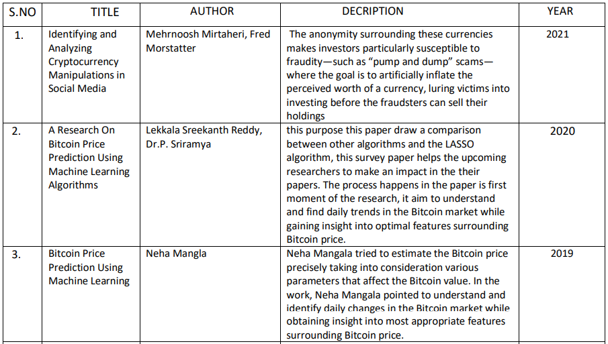
LITERATURE SURVEY

Slide 4
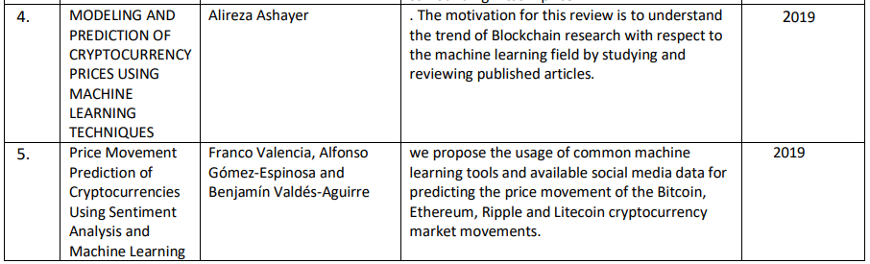
LITERATURE SURVEY

Slide 5
PROBLEM STATEMENT
The machine learning model is used to predict the cryptocurrency outcome.
The application of data science process is applied for getting the better model for predicting the outcome.
Variable identification and data understanding is the main process in building the successful model.
The goal is to develop a machine learning model for Crypto Currency Prediction, to potentially replace the updatable supervised machine learning classification models by predicting results in the form of best accuracy by comparing supervised algorithm.

Slide 6
EXISTING SYSTEM
They presented a computational approach for identifying and characterizing crypto currency pump and dump operations that are carried out in social media.
They had used financial and Twitter data pertaining to a particular coin, the method used was able to detect, with reasonable accuracy
Telegram was a popular choice for scammers to organize and coordinate pump and dump operations.
Disadvantages:
They did not use any specific algorithms for predicting the crypto-currency price
The data which they found are only used to consider to see the only the impact from social media.

Slide 7
PROPOSED SYSTEM
The process start from variable identification like dependent and independent variable where we find the target column.
Then the pre-processing techniques are applied like dealing with the missing values the pre-processed data then used to build a model by dividing the dataset into 7:3 ratio where 70% of the data is used for training purpose that is model learns the pattern and the remaining testing data is used to test the performance of data.
The regression model also can be used to predict the price of the cryptocurrency.
Advantages:
The machine learning algorithms are compared and the performance metric are also calculated for better prediction.
Machine learning model predictions allow businesses to make highly accurate guesses.

Slide 8
SYSTEM REQUIREMENTS
1. Software Requirements:
Operating System : Windows
Tool : Anaconda with Jupyter Notebook
2. Hardware requirements:
Processor : Pentium IV/III
Hard disk : minimum 80 GB
RAM : minimum 2 GB

Slide 9
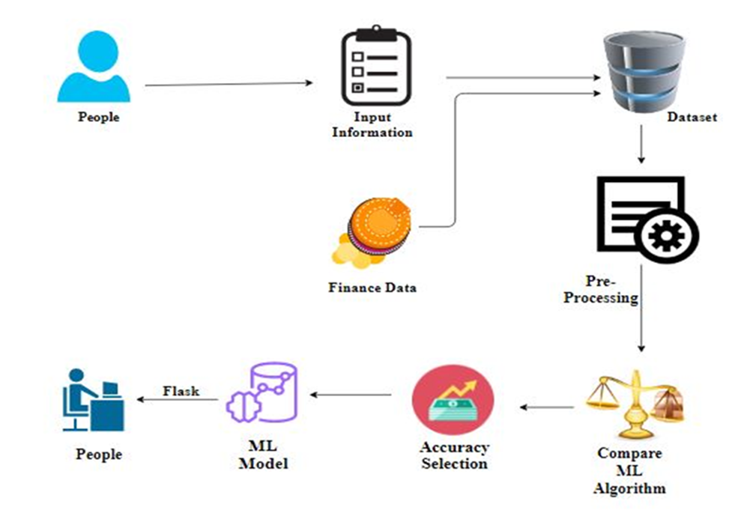
SYSTEM ARCHITECTURE

Slide 10
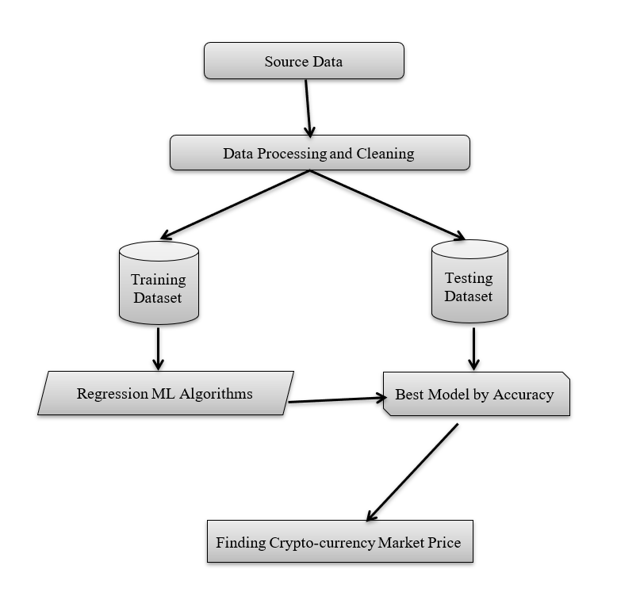
Workflow Diagram

Slide 11
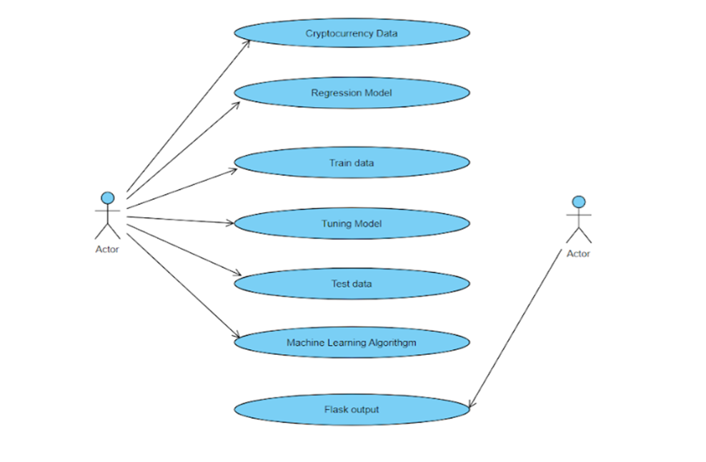
Use Case Diagram

Slide 12
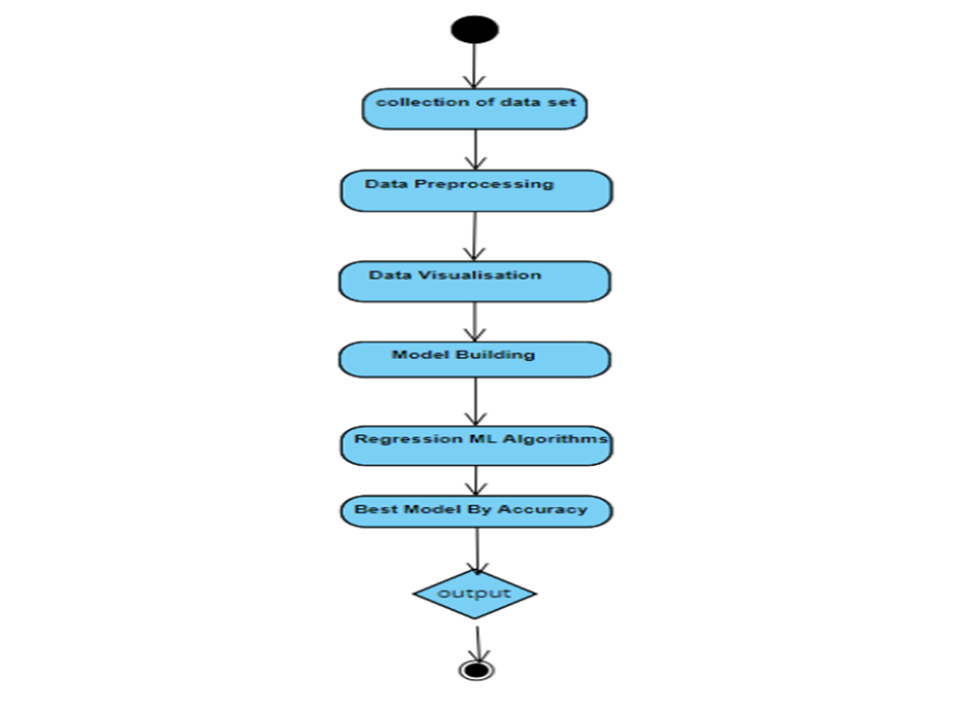
Activity Diagram

Slide 13
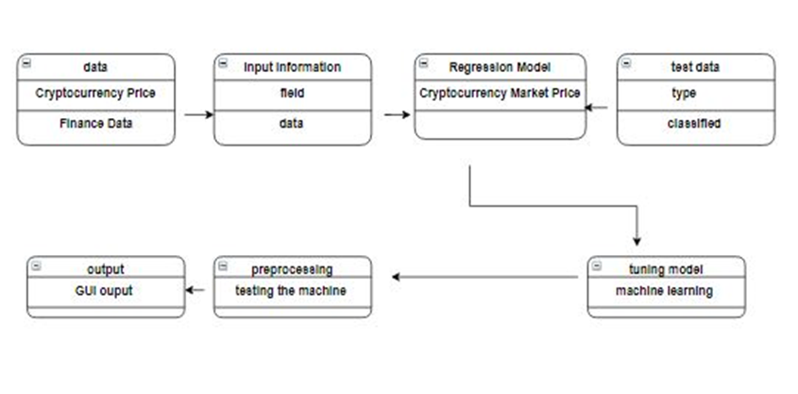
Class Diagram

Slide 14
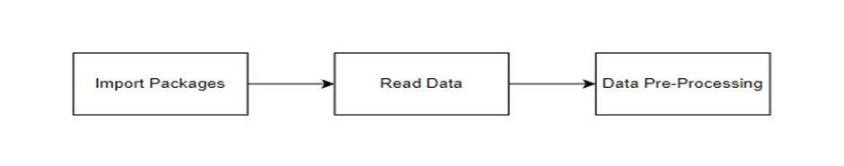
Module 1 Data Pre-processing
GIVEN INPUT EXPECTED OUTPUT
input : data
output : removing noisy data

Slide 15
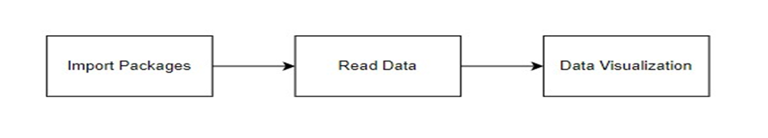
Module 2 Exploration data analysis of visualization
GIVEN INPUT EXPECTED OUTPUT
input : data
output : visualized data

Slide 16
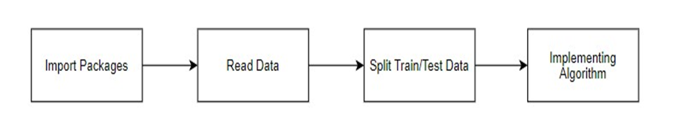
Module 3 Logistic Regression
GIVEN INPUT EXPECTED OUTPUT
Input : Data
Output : Getting Accuracy

Slide 17
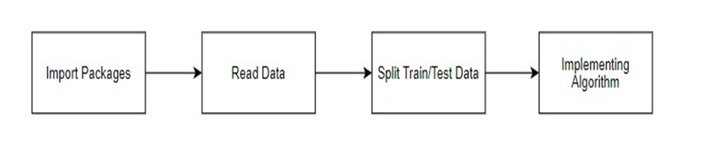
Module 4 Decision Tree Regression
GIVEN INPUT EXPECTED OUTPUT
Input : Data
Output : Getting Accuracy

Slide 18
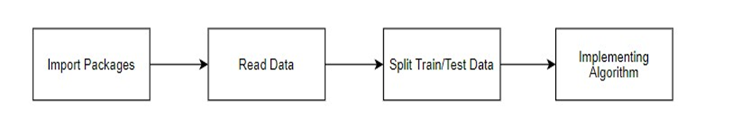
MODULE 5 Support Vector Regression
GIVEN INPUT EXPECTED OUTPUT
input : data
output : getting accuracy

Slide 19
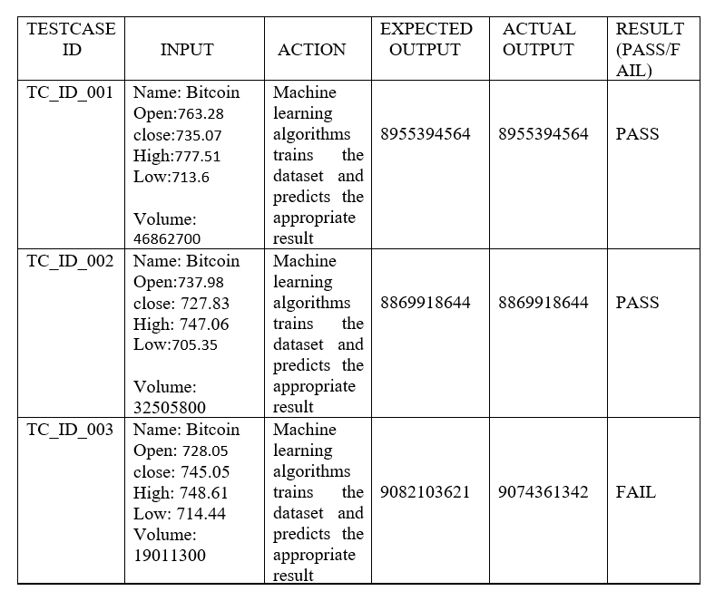
Testing

Slide 20

OUTPUT

Slide 21


Slide 22
CONCLUSION
The analytical process started from data cleaning and processing, missing value, exploratory analysis and finally model building and evaluation. The best accuracy on public test set is higher accuracy score is will be find out. This application can help to find the Cryptocurrency Market Price.

Slide 23
REFERENCES
[1] Mehrnoosh Mirtaheri , Fred Morstatter “Identifying and Analyzing Cryptocurrency Manipulations in Social Media” in IEEE transactions on computational Social System,vol.8,No.3,June 2021
[2] Lekkala Sreekanth Reddy, Dr.P. Sriramya“ A Research On Bitcoin Price Prediction Using Machine Learning Algorithms“ in International Journal of Scientific & Technology research volume 9, issue 04, april 2020
[3] Neha Mangla “Bitcoin Price Prediction Using Machine Learning” in International Journal of Information and Computing science Volume 6, Issue 5, May 2019
[4] Alireza Ashayer “Modeling and prediction of cryptocurrency prices using machine learning techniques” in Computer, vol. 49, no. 6, pp. 38–46, April, 2019
[5] Franco Valencia, Alfonso Gómez-Espinosa and Benjamín Valdés-Aguirre “ Price Movement Prediction of Cryptocurrencies Using Sentiment Analysis and Machine Learning” in Proc. IEEE 13th Int. Conf. Data Mining, pp. 1103–1108 Year 2019
[6]Ruchi Mittal, Shefali Arora and M.P.S Bhatia “Automated cryptocurrencies prices prediction using machine learning ” in ICTACT journal on soft computing, volume: 08, issue: 04 , JULY 2018

Slide 24
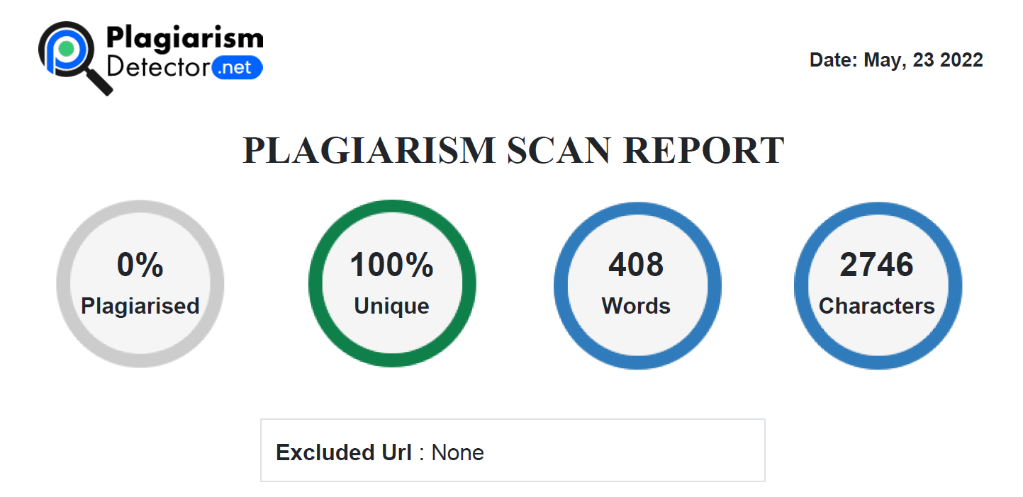
Plagiarism Report

